Slide 1
Trainings 10/18/16
HYPE!!!

Slide 2
2016: Stronghold
The Game
Come up with a strategy and a design for a shooter
Things To Remember:
10 Inch ball
Cannot Shoot/Pass over Defenses

Slide 3
Prototyping and Materials

Slide 4
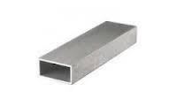
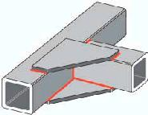
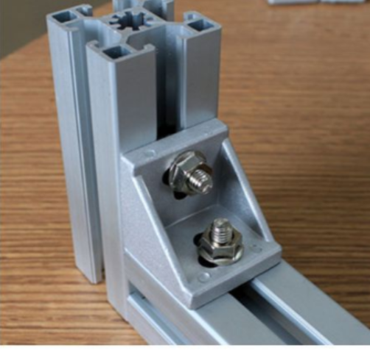
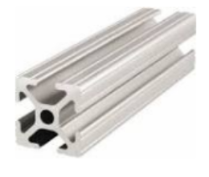
Materials for a Frame
2x1
Gussets
Bosch

Slide 5
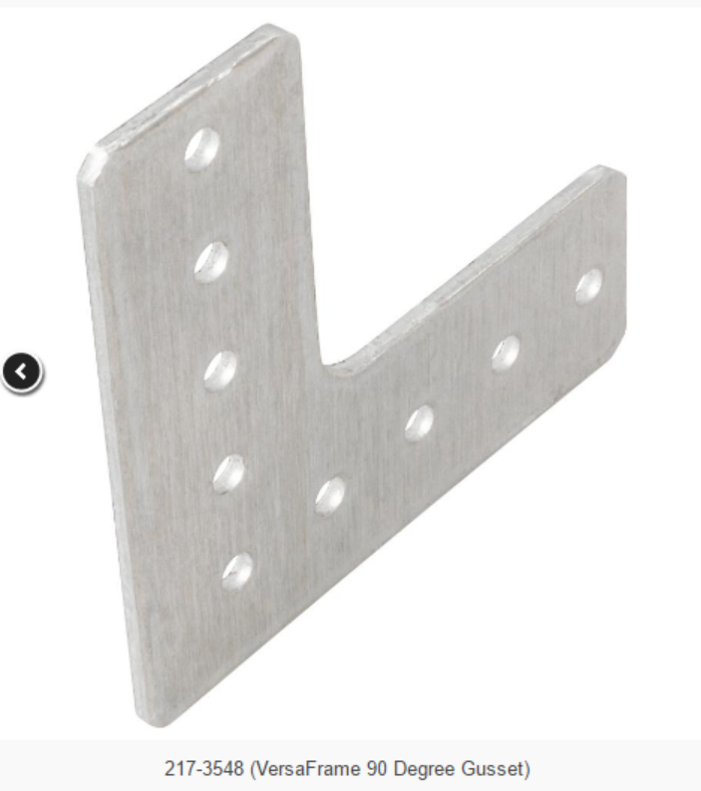
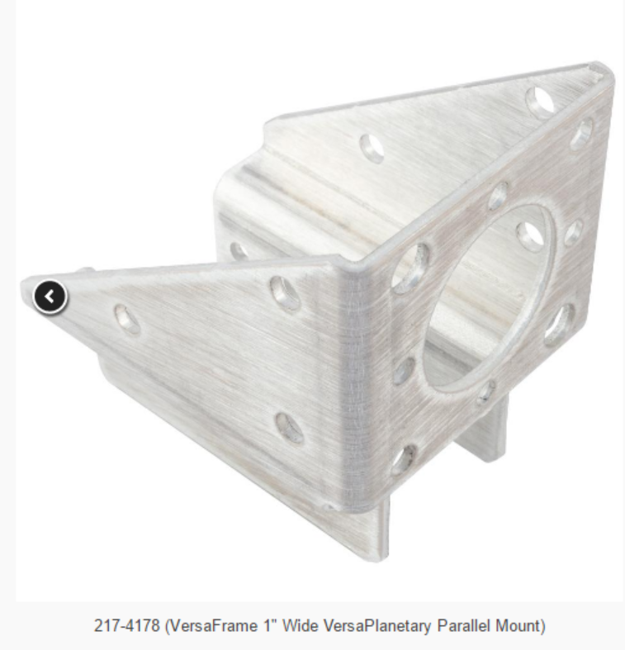
Gussets

Slide 6
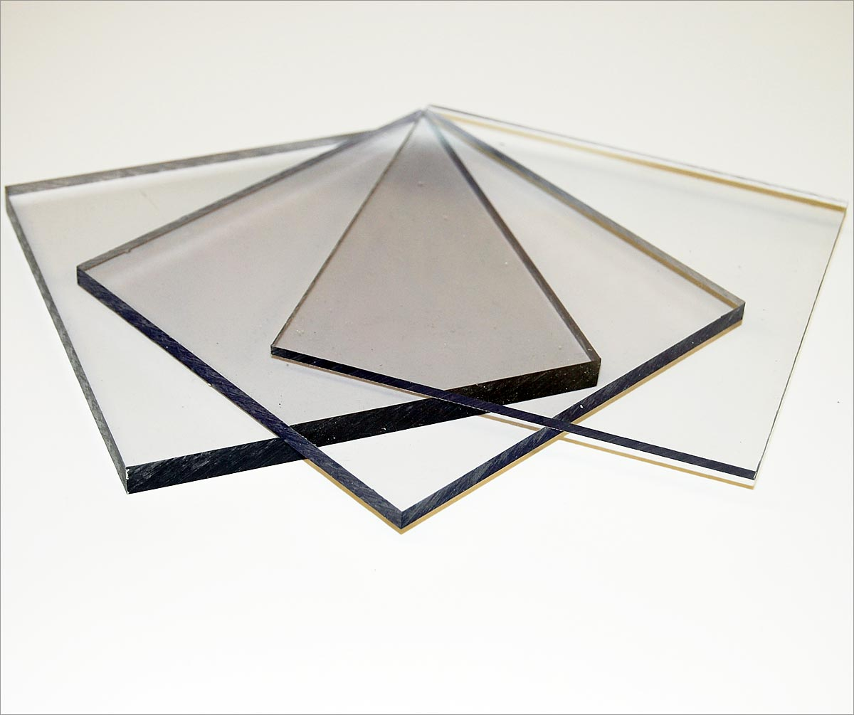
PolyCarb
Easy to cut, manipulate and shape

Slide 7
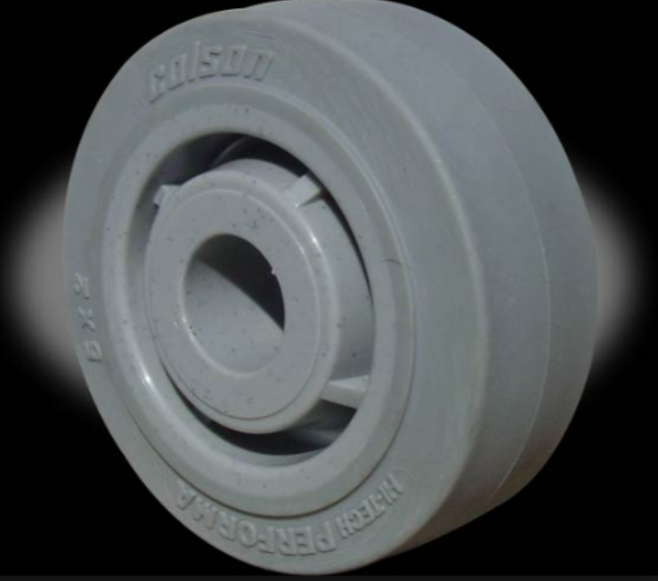
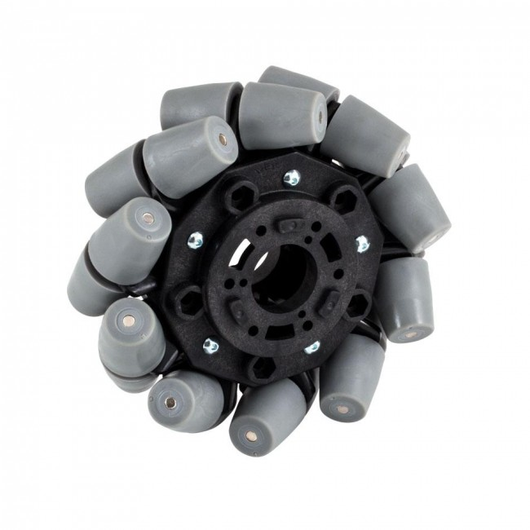
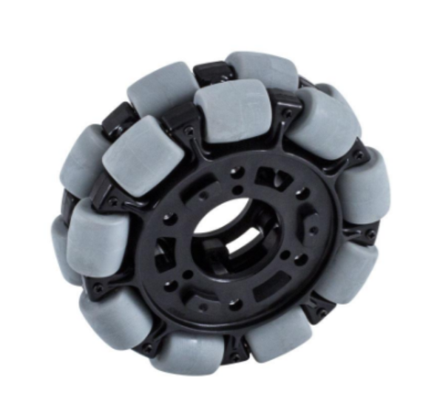
Rotary Parts-Wheels

Slide 8
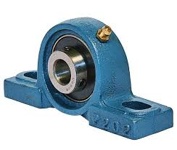
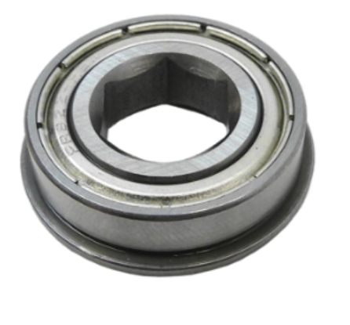
Rotary Parts -Bearings

Slide 9
Wheel assembly/General Bearing Shaft Assembly

Slide 10
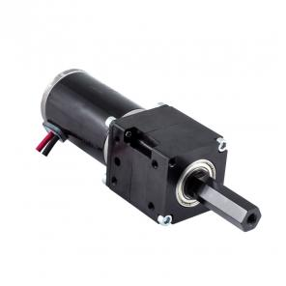
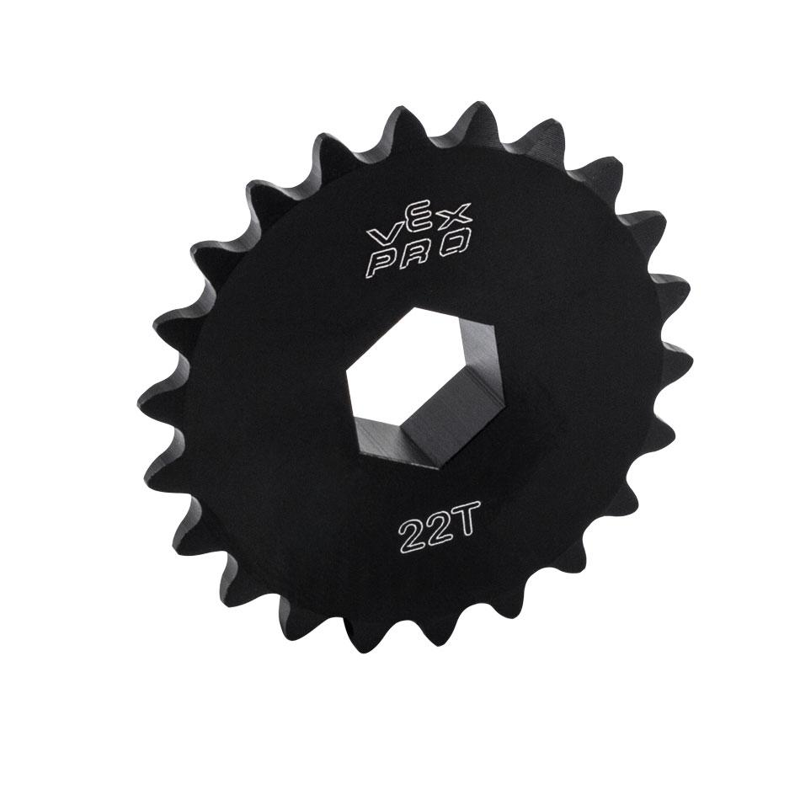
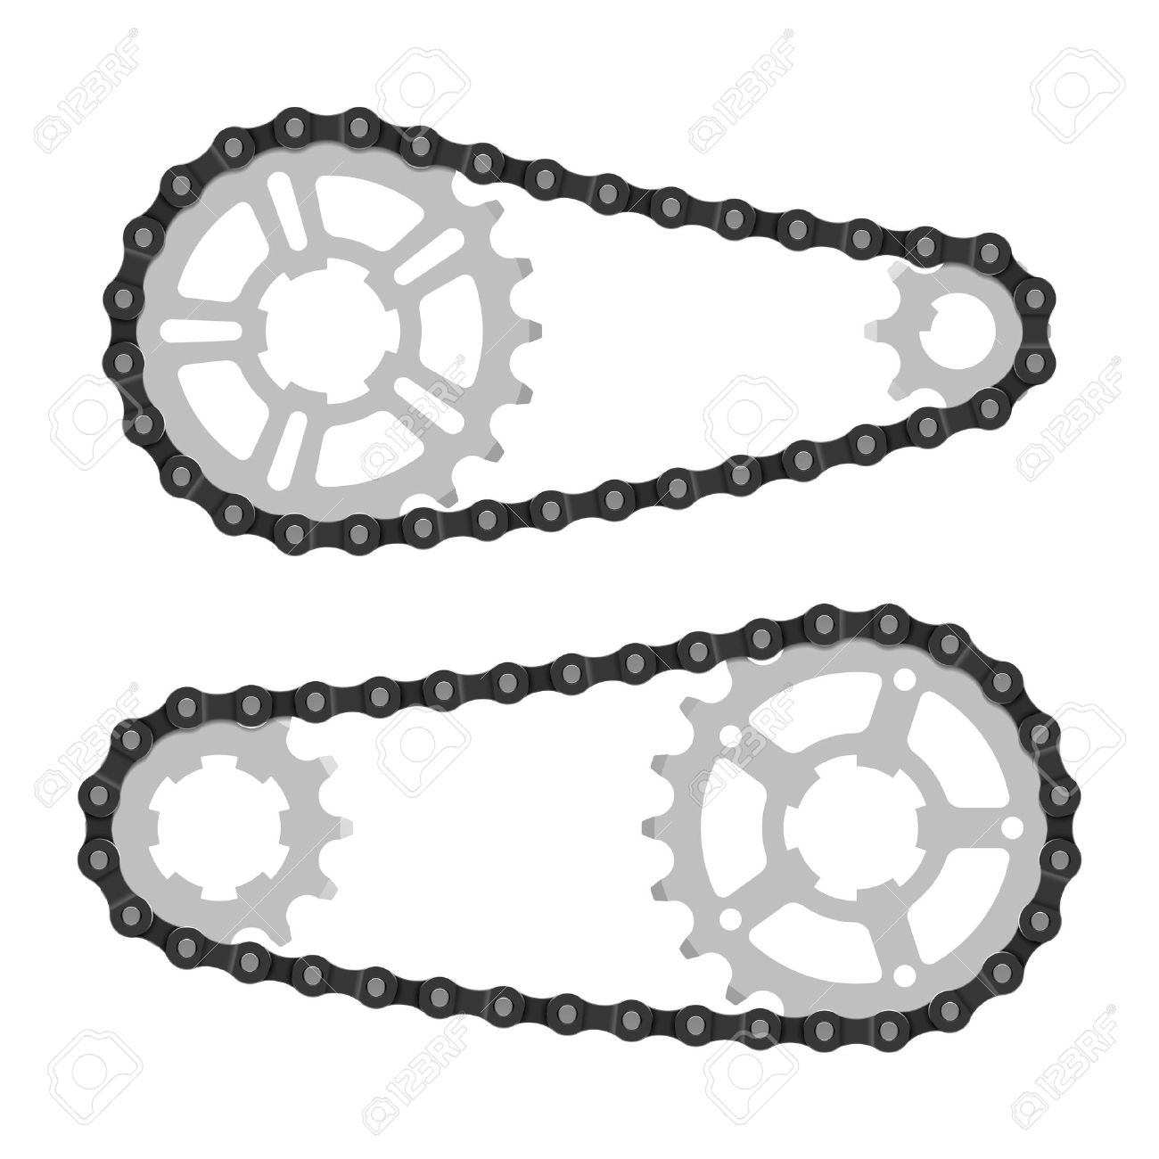
Motors and Gearboxes

Slide 11
Challenge Time!
Your mission if you choose to accept:
Create a working, wired prototype that is able to put a 10” FIRST frc boulder over the fence of the yard (About 8 feet high)
There are no restrictions other than your parts being limited to the FRC realm
Final designs must include:
Material List
Measurements
Laid out mechanical components (Gussets, Wheels, Bearings, Motors )

